Slide 1
OCRe-OBI integration discussion
OBI Workshop
Philly Oct 12-14, 2011
Melissa, Carlo, Philippe, Simona, Samson

Slide 2
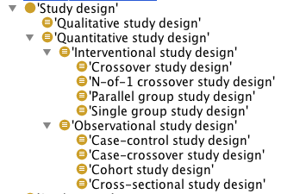
Study Design types in OCRe
OCRe:study design: A study design is a common pattern of relationships (in time and causation) among various study elements (e.g., time of intervention to outcomes assessment in which participants).
(subclass of Value set: Classes that define sets of permissible values.)
OCRe:Interventional study design: An interventional study is a quantitative study that prospectively assigns experimental units (human participants or groups of humans or part of human participants) to one or more health-related interventions to evaluate the effects on health outcomes. Interventions include but are not restricted to drugs, cells and other biological products, surgical procedures, radiologic procedures, devices, behavioural treatments, process-of-care changes, preventive care, etc.
'Quantitative study design'
and ('has design characteristic' some 'Investigator assigns intervention')
OCRE:investigator assigns intervention: The investigator actively assigns the study experimental units to one or more regimens of interventions (each including one or more interventions, or no intervention). (a Value set)

Slide 3
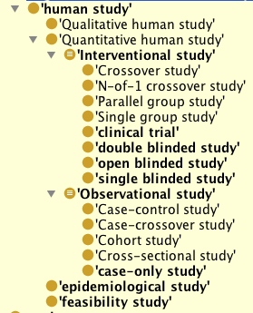
Human study types in eagle-i
ERO:Human study: Research project (planned process) that uses or collects measurements or assessments about humans.
(subclass of Research project: Planned process. Subject of funding. Same as OBI:investigation?)
ERO:interventional study – imported from OCRe, but slightly different logical def.
'Quantitative human study'
and (has_part some intervention)
ERO:intervention: A planned process used to influence one or more factors in a research study, and the independent variable in an interventional study wherein the influence is measured or evaluated. (a planned process)

Slide 4
Study Design types in OBI
OBI:study design: A study design is a plan specification comprised of protocols (which may specify how and what kinds of data will be gathered) that are executed as part of an investigation and is realized during a study design execution.
OBI:intervention design: An intervention design is a study design in which a controlled process applied to the subjects (the intervention) serves as the independent variable manipulated by the experimentalist. The treatment (perturbation or intervention) defined can be defined as a combination of values taken by independent variable manipulated by the experimentalists are applied to the recruited subjects assigned (possibly by applying specific methods) to treatment groups. The specificity of intervention design is the fact that independent variables are being manipulated and a response of the biological system is evaluated via response variables as monitored by possibly a series of assays.
'study design'
and (has_part some
('independent variable specification'
and ('is about' some 'study intervention')))
OBI:study intervention: The part of the execution of an intervention design study which is varied between two or more subjects in the study. (a planned process)

Slide 5
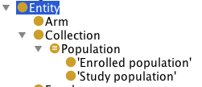
Population
In OBI: A population is a collection of individuals from the same taxonomic class living, counted or sampled at a particular site or in a particular area.
(material entity)
In OCRe: A population is a collection of organisms.
Collection
and ('has element' only Organism)
Study population: The group of people being studied, usually by taking samples from that population. Populations may be defined by any characteristics e.g. geography, age group, certain diseases."

Slide 6
Population- OBI tracker item
http://sourceforge.net/tracker/?func=detail&aid=3411758&group_id=177891&atid=886178
Proposal to add subtypes of population, to OBI - to make accessing those entities less complex:
-study group population with 2 subtypes:
--treatment group population (syn: treated population)
defined as a:
specified_output_of some 'obo:group assignment)
ro:has_part only (obo:organism and (roproposed:bearer_of some 'obo:to be treated with active ingredient role'))
--control group population (syn: control population)
defined as a :
specified_output_of some 'obo:group assignment
ro:has_part only (obo:organism and (roproposed:bearer_of some 'obo:to be treated with placebo role'))
add 'cohort' too as subtype of population where the assignment criteria could be 'being born in the same year or same time period and possibly in a circumscribed location (based on the Oxford English Dictionary).

Slide 7
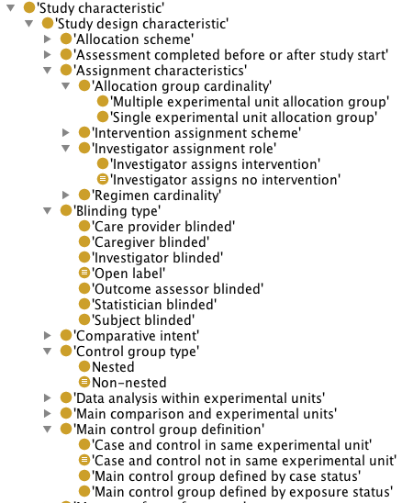
OCRe – Study characteristics

Slide 8

Study subjects
In OBI:
definition "study subject role inheres in an entity and realized through the execution of a study design in which the entity participates by being that which the results are about."
is_concretization_of some
('intervention design'
or 'observation design')
is_realized_by only 'study design execution'

Slide 9
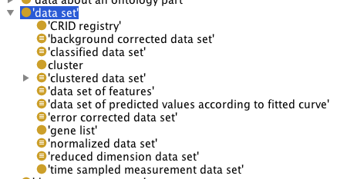
Data set and measurements
IAO data sets:
Definition: A data item that is an aggregate of other data items of the same type that have something in common. Averages and distributions can be determined for data sets.
OCRE needs to model data collected as results of conducting studies.

Slide 10
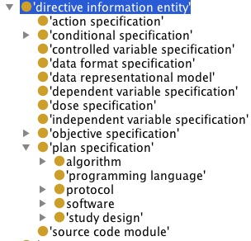
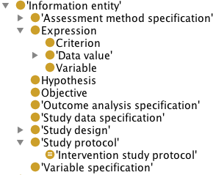
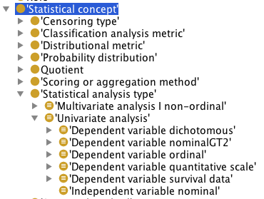
Directive information entity: we share in common notions of independent and dependent variable specifications, protocol.
IAO/OBI
OCRE

Slide 11
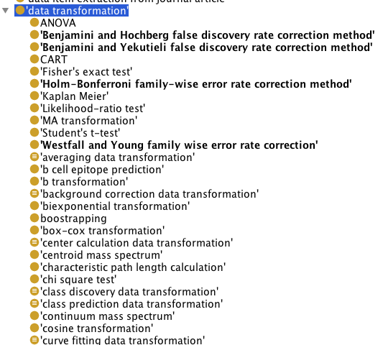
Statistical methods
OBI
OCRE

Slide 12
BFO related problems with OCRE:
properties of processes: e.g. class “assignment properties”
Class “Value Set” seems a ‘rag-bag’ where very different entities are binned
( e.g. Blood is_a Value_Set or Study_design is_a Value_Set,
biospecimen preservation method as in “slow freeze” should be processes)
Event has a subclass “Study Administration Relation” which,
according to the definition is a kind of “relationship”. Only a matter of class label
but currently confusion. s/relation/process|legally binding process/
Statistical Concepts:
Should be reorganized to go either into IAO/generically dependent continuant
Summary:
-Go for quick wins where reorganization is obvious and would bring closer
Integration / interoperability between OBI and OCRE.
-Engage with BFO for thorny issues.

